Slide 1
An end-to-end deep CNN
for BCI classification task
Using EEG data
Aras Dargazany

Slide 2
Motive
Data features
Local feature extraction:
1- spatial filtering, e.g.
Spatial Laplacian filter,
2- temporal filters, e.g. Morlet Wavelet and Hilbert
Manual features: mean, peak, skewness and kurtosis (momentums)
Linear classifier: SWLDA, LDA, and Bayesian (supervised machine learning)
Class labels
Global feature extraction: PCA & ICA (unsupervised machine learning)
Nonlinear classifier: ANN and SVM (supervised machine learning)
Convolutional NN (CNN): local feature extraction & global feature extraction & classification
End-to-End Deep Convolutional NN (CNN): deep local feature extraction, global feature extraction & classification

Slide 3
Motive
Data features
End-to-End Deep Convolutional NN (CNN): deep local feature extraction, global feature extraction & classification
BCI perspective:
Simplifying the classification pipeline
Are all these preprocessing necessary and needed?
DL perspective:
Applying CNN to signal processing rather than image processing
Dealing with this misconception that CNN is an image processing tool
Comparing with RNN and maybe CNN+RNN combinations as well.
Convolution was mainly developed for signal processing
Class labels

Slide 4
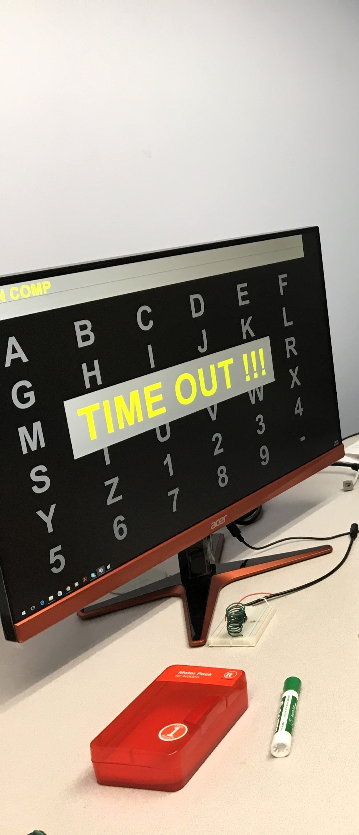
BCI EEG Data Collection
Data was collected in P300 setup using BCI2000 software
Visual stimuli, eeg response (action potential), 300 milisec seq length
Target vs non-target detection for all subjects
Target is where the subject is looking at which character or face
Five subjects participated: 4 males and 1 female (all student age ;)
All subjects were exposed to stimuli such as Faces vs Flipped char in rows
Five subjects data divided into face and flip
Labels were 83.333% non-target vs 16.333% target (problematic!!)
Labels were very unbalanced/ non-uniform distribution
Data were RAW, no filtering or pre-processing applied
Input data features were only normalized
Labels were one-hot encoded/vectorized (two classes).

Slide 5
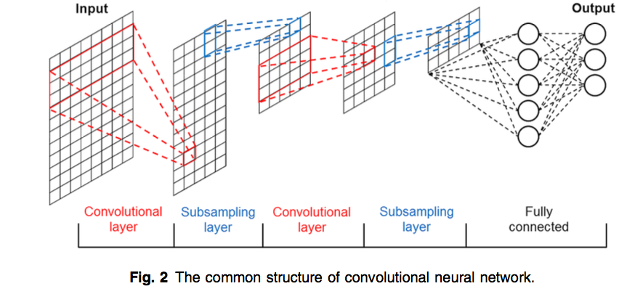
End-to-end
deep CNN
Input data feature: NxCxL vs NxCxHxW vs NxCxDxHxW
Local feature extraction using 1D convolutional filters
Max pooling for subsampling/ downsampling
Global feature extraction and fusion: fully connected/ dense layer
Function approximation or classification
Class probability generation using softmax
Loss function cross entropy
Backprop-SGD-Adam
Trakoolwilaiwan, Thanawin, et al. "Convolutional neural network for high-accuracy functional near-infrared spectroscopy in a brain–computer interface: three-class classification of rest, right-, and left-hand motor execution." Neurophotonics5.1 (2017): 011008.

Slide 6
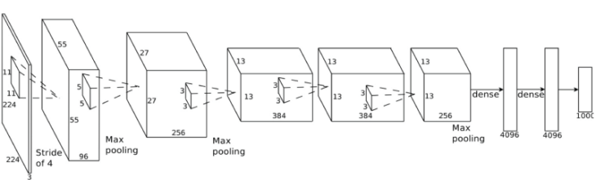
End-to-end
deep CNN
Hyperparameters:
batch_size = 150
seq_len = 205
n_channels = 16
N_class = 2
learning_rate = 0.0001
epochs = 100
keep_prob = 0.50
Layer 1: conv (filter = 32, size = 2, stride = 2, pad = valid) + pool (size = 2, stride = 2, pad = same)
inputs_.shape, conv1.shape, max_pool_1.shape: (?, 205, 16) (?, 204, 32) (?, 102, 32)
Layer 2: conv (filter = 64, size = 2, stride = 2, pad = same) + pool (size = 2, stride = 2, pad = same)
max_pool_1.shape, conv2.shape, max_pool_2.shape: (?, 102, 32) (?, 102, 64) (?, 51, 64)
Layer 3: conv (filter = 128, size = 2, stride = 2, pad = valid) + pool (size = 2, stride = 2, pad = same)
max_pool_2.shape, conv3.shape, max_pool_3.shape: (?, 51, 64) (?, 50, 128) (?, 25, 128)
Layer 4: conv (filter = 256, size = 2, stride = 2, pad = valid) + pool (size = 2, stride = 2, pad = same)
max_pool_3.shape, conv4.shape, max_pool_4.shape: (?, 25, 128) (?, 24, 256) (?, 12, 256)
Layer 5: Flattening/reshape + Dropout with 50% + FC/dense layer to Output classes
max_pool_4.shape, flat.shape, logits.shape: (?, 12, 256) (?, 3072) (?, 2)

Slide 7
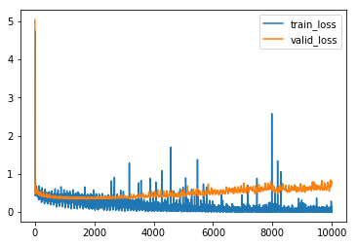
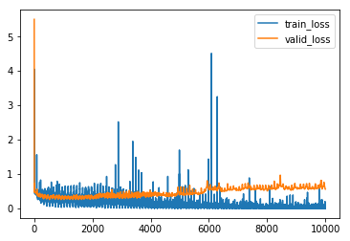
Results on all subject
Faces & Flip: Overfitting
Face
Epoch: 100/100 Train loss: 0.003697 Valid loss: 0.468953
Epoch: 100/100 Train acc: 1.000000 Valid acc: 0.877434
Epoch: 100/100 Test loss: 0.192754 Test acc: 0.927739
Overfitting is happening
Flip
Epoch: 100/100 Train loss: 0.003697 Valid loss: 0.468953
Epoch: 100/100 Train acc: 1.000000 Valid acc: 0.877434
Epoch: 100/100 Test loss: 0.698612 Test acc: 0.880451
Overfitting is happening
Overfitting: Unbalanced label distribution 83.33 % Non-target vs 16.66 target (min accuracy is 83.33)

Slide 8
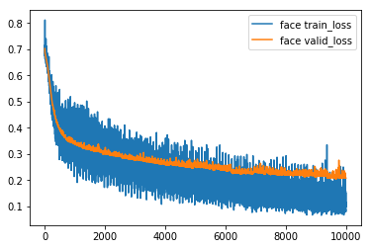
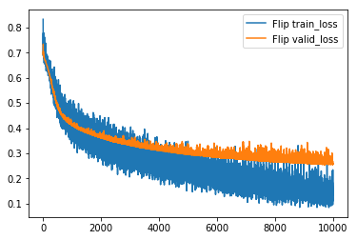
Results on all subject
Faces & Flip: Final
Face
Epoch: 100/100 Train loss: 0.22439 Valid loss: 0.27381
Epoch: 100/100 Train acc: 0.90944 Valid acc: 0.89355
Test loss: 0.19275 Test acc: 0.92773
Overfitting is solved :)
Flip
Epoch: 100/100 Train loss: 0.271902 Valid loss: 0.332531
Epoch: 100/100 Train acc: 0.884477 Valid acc: 0.857548
Test loss: 0.261808 Test acc: 0.891207
Overfitting is solved :)
Overfitting solution: Unbalanced label distribution solved by data augmentation, adding 5 times of linearly transformed 16.66 target to 83.33 % Non-target → 50% vs 50% new distribution

Slide 9
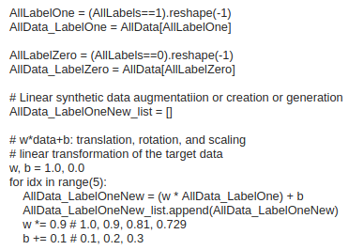

Overfitting problem, solution & feedback
Adding linearly transformed target data (16.66 % * 5 times)
Linearly transformed augmented/ added data are linearly separable
Solves the overfitting problems without adding more complexity to the nature of nonlinear classification task 83.33% vs 16.66% (this focus of this BCI project)
Still needs more research & analysis though - too soon to jump into any conclusion :(

Slide 10

Final point
Convolutional vs conventional for BCI classification pipeline:
Cons:
CNNs are computationally heavy (GPUs needed).
They need a lot of data (data hungry).
End-to-end possible but overfitting.
Big pros:
Makes BCI classification simple enough.
Proves CNN useful for signal processing as well as image processing

Slide 11
“Try to make things simple enough but not simpler than that”
- Probably from Einstein
Provable by Heisenberg uncertainty principle

